Slide 1
Krazy 4 Kratom
Ashley Haynes, MD, FACEP
March 6, 2020
SD ACEP

Slide 2
Disclosures
I have no financial relationships to disclose.

Slide 3
Objectives
1. Identify the psychoactive components of Kratom
2. Discuss the mechanisms for toxicity of Kratom
3. Discuss the current legal status of Kratom

Slide 4
What Is Kratom?
Tropical tree that is indigenous to SE Asia (Thailand, Malaysia)
Like coca or khat, kratom leaves are chewed or prepared as a powder or juice
Low dose (1-5 g): stimulant effects used to reduce fatigue in laborers
Moderate dose (5-15 g): opioid effects
High dose (> 15 g): severe opioid effects including stupor

Slide 5
Kratom Metabolism
CYP 2D6
CYP 3A4
Notes:
MOR = mu opioid receptor

Slide 6
Scheduling of Kratom?
8/30/2016
DEA announced intention to schedule mitragynine and 7-hydroxymitragynine as schedule I
(No currently accepted medical use, high potential for abuse)
Large protests ensued
10/12/2016
DEA withdrew intent-to-schedule notice to gather data
To date, DEA still has not scheduled kratom compounds
October 2017,
Department of Health & Human Services recommended mitragynine and 7-OH-mitragynine be “permanently controlled in Schedule I of the [Controlled Substances Act].”

Slide 7
Scheduling of Kratom?
Banned in several states:
Classified as a Schedule I substance:
Alabama, Arkansas, Indiana, Tennessee, Vermont, and Wisconsin
District of Columbia
Sarasota County, FL, San Diego County, CA, and Denver, CO
Currently, listed as a “Drug or Chemical of Concern” by the DEA
To date, DEA still has not scheduled kratom compounds
Notes:
Schedule
Definition
Examples
I
No currently accepted medical use
High potential for abuse
Heroin, LSD, marijuana, MDMA, peyote
II
Do have an accepted medical use
High potential for abuse
Hydrocodone, methadone, cocaine, meth, fentanyl
III
Do have an accepted medical use
Moderate potential for abuse
Codeine, ketamine, anabolic steroids
IV
Do have an accepted medical use
Low potential for abuse
Alprazolam, carisoprodol, tramadol, zolpidem
V
Do have an accepted medical use
Low quantities of opioids
Atropine/diphenoxylate, pregabalin, cough syrup

Slide 8
Kratom Controversy
11/2017:
No FDA-approved therapeutic uses of kratom
Significant safety issues
36 kratom-ass’d deaths
2/2018:
Computational model c/w mitragynine being an opioid
44 kratom-ass’d deaths
However, most cases could not be fully assessed
FDA issues warnings regarding risk and recommended non-use of products
https://www.cnbc.com/2017/11/15/herbal-anti-opioid-supplement-kratom-could-fuel-new-addiction-fda.html
Notes:
FDA commissioner Scott Gottlieb
As of 2011, the plant was controlled in Denmark, Latvia, Lithuania, Poland, Romania and Sweden.^{[17]} In the UK, since 2016, the sale, import, and export of kratom are prohibited under the Psychoactive Substances Act.^{[54]}
In 2017, kratom was designated a Schedule 1 illegal drug (the highest level) in the Republic of Ireland, under the names 7-hydroxymitragynine and mitragynine

Slide 9
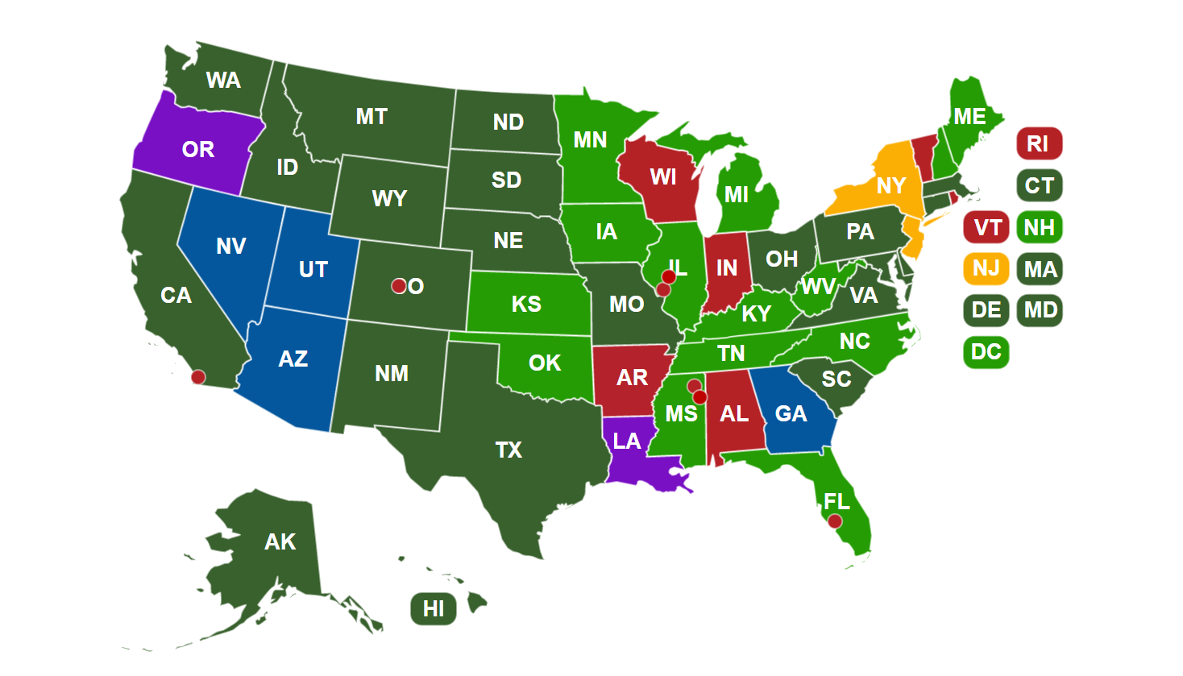
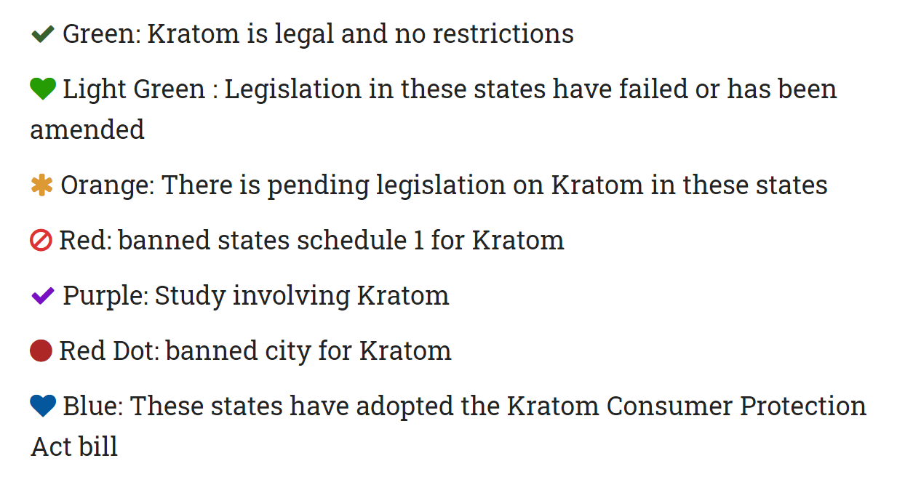
Kratom Legality in the United States
http://speciosa.org/home/kratom-legality-map/

Slide 10
Kratom Consumer Protection Act
A bill to:
Regulate the preparation, distribution, and sale of kratom products
Prohibit the preparation, distribution, and sale of adulterated or contaminated kratom products
Prescribe fines and penalties and allow remedies
Provide for the powers and duties of certain state governmental officers and entities.

Slide 11
Kratom-Associated Toxicity and Deaths
 | Southeast Asia | West (US and Europe)
Side Effects | Weight loss, dehydration, constipation, skin hyperpigmentation | N/V, stomach pain, chills and sweats, dizziness, unsteadiness, visual sx
Toxicity | No literature reports of serious toxicity or death | Seizures, hepatotoxicity, coma, multiple deaths
Where Obtained | Locally | Internet, head shops
How Used | Usually used alone (but not always) | Often combined with other drugs
Legal Status | Illegal in Thailand, Malaysia | Legal in most of US and Europe

Slide 12
Kratom Effects are Dose-Dependent
Dose | Overall Effect | Clinical Manifestations
Low to Moderate (1-5g raw leaves) | Mild stimulant | ↑ alertness and energy Talkativeness, sociability ↑ libido
Moderate to High (5-15g raw leaves) | Opioid-like | Pain relief Opioid withdrawal relief Mild euphoria
Very High (> 15g raw leaves) | Stupor | Sweating, dizziness, nausea Dysphoria “calm and dreamlike state”

Slide 13
Kratom Use in SE Asia
“4 x 100” Cocktail
Traditional uses
Laborers (stimulant activity)
Pain and other ailments
Modern uses
Opioid withdrawal or other drug addiction issues
Recreational use
https://www.cbc.ca/fifth/blog/more-on-4-x-100
Notes:
Kratom tea, cough syrup, Coca-cola, and ice cubs

Slide 14
Kratom Use in the West: Improve Health
Green Vein
Red Vein
White Vein
Effects
Effects
Effects
Gentle stimulation
Better concentration
Mood lifting
Pain killing
Sedating/relaxing
Insomnia
High energy
Better productivity
Help with depression
http://borrabnudfilms.blogspot.com/2018/07/
Notes:
middle-aged, has at least middle income, private health insurance, and completed some college

Slide 15
Kratom Use in the West: Opioid Withdrawal
https://opiateaddictionsupport.com/how-to-use-kratom-for-opiate-withdrawal/

Slide 16
Kratom Use in the West: Recreational
http://www.elpasosmokeshops.com/kratom/

Slide 17
Are there any kratom-only deaths?
None with convincing evidence
Routine testing does not detect mitragynine
Most cases lack comprehensive toxicological testing
One lab study in CO retested blood samples from four “kratom-only” deaths using HPLC-MS
Three of the four cases were found to contain multiple drugs
The fourth case had insufficient residual blood to be comprehensively tested
However, warning: It is likely that mitragynine increases the risk of adverse events, especially when ingested with opioids or psychoactive drugs
Gershman et al. Deaths in Colorado Attributed to Kratom. NEJM 2019 Jan 3.

Slide 18
Kratom Withdrawal
In one study, 6 months of use associated with withdrawal
Generally similar to opioid withdrawal syndrome
Buprenorphine, methadone, naltrexone outpatient treatment options
Voelker R. Crackdown on false claims to ease opioid withdrawal symptoms. JAMA. 2018;319:857.
Singh D, et al. Kratom (Mitragyna speciosa) dependence, withdrawal symptoms and cravings in regular users. Drug and Alcohol Dependence. 2014;139:13
Neonatal abstinence syndrome reported
Presentation similar to opioid NAS
Treated with opioid taper
Davidson, et al. Natural Drugs, Not so Natural Effects. J Neonatal Perinatal Med. 2019 (12):1.
Eldridge, et al. Neonatal Abstinence Syndrome Due to Maternal Kratom Use. Pediatrics. December 2018.

Slide 19
Proposed Kratom Mechanisms of Action
Receptors Affected
Partial agonism of μ, κ, and δ opioid receptors
Agonism of α₂ receptors
Antagonism of 5-HT_{2A} receptors
Ion Channels Affected
Blocking of K⁺ channels
Blocking of Ca²⁺ channels
Other Mechanisms
5-HT and NE reuptake inhibition
Inhibition of CYP3A4 and CYP2D6
Notes:
Alpha 2: Guanabenz, guanfacine, clonidine, tizanidine, medetomidine, and dexmedetomidine, presynaptic/neg feedback – inhibits ne release presynaptic,n locus ceruleus – sedation, dorsal horns – pain modification

Slide 20
Proposed Mechanism of Toxicity: Respiratory Depression
Multiple case reports of CNS depressant mixes
17 y/o WM found dead after using diphenhydramine, DXM, temazepam, clonazepam and mitragynine
Middle aged male found dead after using zopiclone, citalopram, lamotrigine and mitragynine
Autopsies: pulmonary edema and congestion

Slide 21
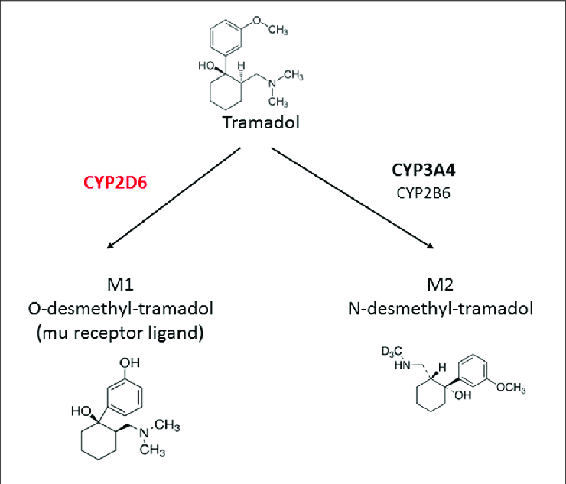
Adulteration of Kratom with Opioids
Krypton = mixture of kratom + O-desmethyltramadol, the active metabolite of tramadol
O-desmethyltramadol is twice as potent as tramadol
Case series of nine deaths from Sweden from krypton
All had evidence of opioid overdose, including 8 with pulmonary edema
No parent drug (tramadol) and no other metabolites found
Lydecker, et al. Suspected Adulteration of Commercial Kratom Products with 7-Hydroxymitragynine. J Med Toxicol. December 2016.
https://www.researchgate.net/publication/323556173_When_the_Safe_Alternative_Is_Not_That_Safe_Tramadol_Prescribing_in_Children/figures?lo=1

Slide 22
Suspected Adulteration of Kratom Supplements
Analysis of multiple kratom products was notable for higher-than-natural concentrations of 7-hydroxymitragynine in most products tested
Significant b/c 7-hydroxymitragynine is the most active component of kratom (17x higher μ opioid receptor affinity than morphine)
Likely a major contributing factor to the addictive potential and abuse liability of kratom
Authors conclude that the products were likely deliberately adulterated w/ 7-hydroxymitragynine
Lydecker, et al. Suspected Adulteration of Commercial Kratom Products with 7-Hydroxymitragynine. J Med Toxicol. December 2016

Slide 23
Proposed Mechanism of Toxicity: Stimulatory
Case report of modafinil + kratom causing sz
43 y/o male on chronic kratom took a dose of modafinil
Had a seizure 20 minutes post-ingestion
Mechanism of the seizure is uncertain
Modafinil is a DRI and not known to cause sz on its own
Kratom not known to cause sz on its own
Pt had been on kratom alone w/out issue for >3 years
Boyer, et al. Self-treatment of opioid withdrawal using kratom (Mitragynia speciosa korth). Addiction. 2008.

Slide 24
Proposed Mechanism of Toxicity: K⁺ Blockade
Inhibition of hERG K⁺ channel (rapid repolarizing)
Most common cause of acquired prolonged QT
Can cause drug-induced torsades and sudden death
Found to be blocked by mitragynine
Inhibition of inward rectifier K⁺ channels responsible for stabilizing resting potential
Effect of blockade of these channels less well-established
Also blocked by mitragynine

Slide 25
Proposed Mechanism of Toxicity: Prolonged QTc
Multiple case reports of QTc prolonging mixes
17 y/o WM found dead after using diphenhydramine, DXM, temazepam, clonazepam and mitragynine
Middle aged male found dead after using zopiclone, citalopram, lamotrigine and mitragynine
3rd case: 24 y/o male found dead after using venlafaxine, diphenhydramine, and mirtazapine w/ mitragynine

Slide 26
Partial List of Drugs Metabolized by CYP2D6
TCAs | SSRIs, Atypicals | Neuroleptics | Analgesics
amitriptyline | fluvoxamine | chlorpromazine | codeine
clomipramine | fluoxetine | clozapine | dextromethorphan
desipramine | mirtazapine | haloperidol | ethylmorphine
imipramine | paroxetine | olanzapine | hydrocodone
maprotaline | sertraline | perphenazine | oxycodone
nortriptyline | venlafaxine | risperidone | tramadol

Slide 27
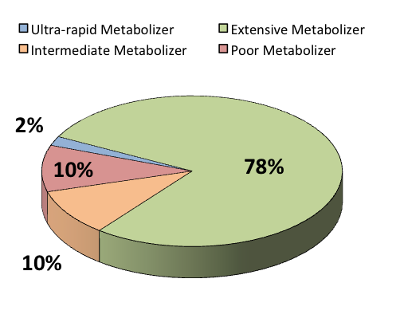
Proposed Mechanism of Toxicity: CYP2D6 Inhibition
https://www.premiertox.com/post/variable-cyp2d6-metabolism-of-opioids
Notes:
Poor Metabolizer (PM)
Slowed drug metabolism
↑ potential for drug-drug interactions and adverse effects, slower conversion to active metabolites, potentially ↓ efficacy
Ultrarapid Metabolizer (UM)
Accelerated drug metabolism
Greater rates of drug elimination, potentially lower drug efficacy

Slide 28
Ethnic Incidence of CYP2D6 Enzyme Phenotypes
Population | PM Phenotype % | UM Phenotype %
White: American | 7.7 | 4.3
White: Spanish | - | 10
White: British | 8.9 | -
White: Swedish | - | 1
Black: American | 1.9-7.3 | 4.9
Black: South African | 19 | -
Hispanic: Mexican | 3.2 | -
Asian: Indian | 1.8-4.8 | -
Asian: Chinese | <1.0 | 0.9
Asian: Thai | 1.2 | -

Slide 29
Proposed Mechanism of Toxicity– P450 3A4 Interactions
Metabolizes >50% of pharmaceuticals
Large interperson variability
Potent 3A4 inhibitors:
clarithromycin, diltiazem, erythromycin, itraconazole, ketoconazole, ritonavir, and verapamil
Common inducers:
phenobarbital, phenytoin and rifampicin, also glucocorticoids
Multiple herbs: goldenseal, black pepper, Schisandra, St John’s wort, Grapefruit

Slide 30
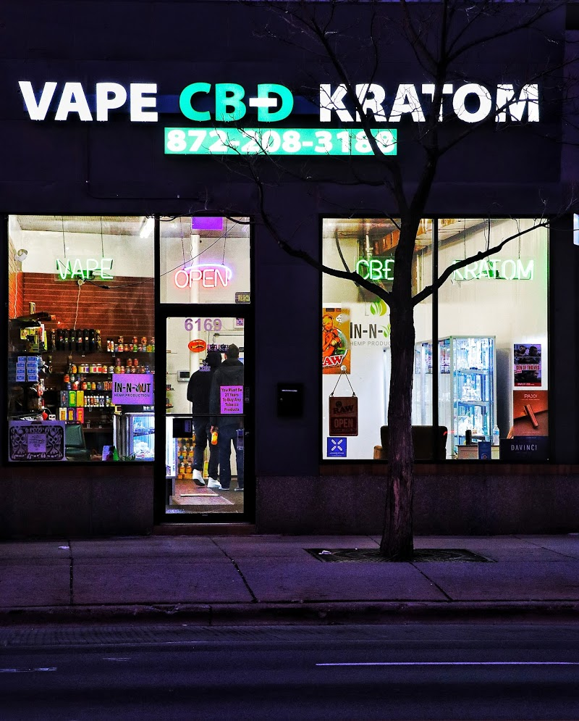
Summary of Proposed Kratom Toxicity Mechanisms
Behavioral Factors
Buying kratom products online/in stores vs locally
Mixing it with other substances vs. using it alone
Pharmacological Factors
Opioid respiratory depression potentiation
Stimulatory: possible status epilepticus
QTc prolongation and torsades/sudden cardiac death
Different CYP2D6 activity in SE Asia vs. the West

Slide 31
Kratom Toxicity Workup and Treatment
Workup
Good history and physical exam
Consider the possibility of withdrawal in regular users
EKG: look for QTc prolongation
UDS unlikely to be helpful
Tx: supportive

Slide 32
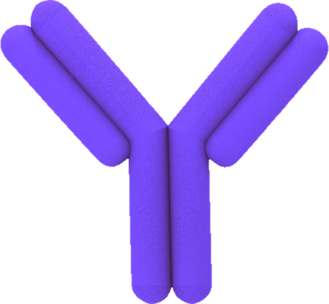
Kratom Does not Trigger Urine Drug Screen
IMMUNOASSAYS
Detection
(“assay”)
Antibody
(“immune”)
Drug
Notes:
Analyte from the patient’s specimen competes for a limited number of antibody binding sites with a known amt of a labeled version of the analyte provided in the reaction mixture
The signal from the labeled moiety is altered by the binding to the assay antibody

Slide 33
How do DOA screens work?
drug
Notes:
Analyte from the patient’s specimen competes for a limited number of antibody binding sites with a known amt of a labeled version of the analyte provided in the reaction mixture
The signal from the labeled moiety is altered by the binding to the assay antibody

Slide 34
Why do false negatives occur?
drug

Slide 35
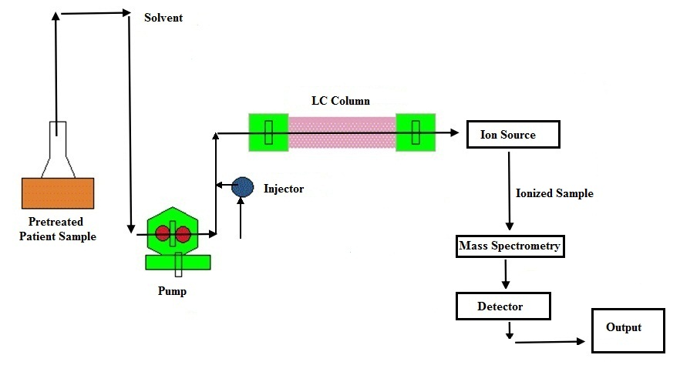
Drug Testing for Kratom
LC/MS
Notes:
Chromatography – separation into individual components
Mass spectrometry – highly sensitive detector – identifies compounds by mass analysis

Slide 36
Drug Testing for Kratom
Notes:
Injection time, injection solvent reaches detector, separated compounds at t1-4 – could be metabolites or co-occurring substances

Slide 37
Will naloxone work?
A definite maybe
One case report detailing successful resuscitation of an opioid toxidrome that was attributed to sole kratom use
Use of other opioids was r/o by GC/MS
Doesn’t specify which opioids were tested for
Overbeek, et al. Kratom (Mitragynine) Ingestion Requiring Naloxone Reversal. Clin Pract Cases Emerg Med. Feb 2019.
If the pt presents with an opioid toxidrome, give naloxone
But use it to treat respiratory depression
Notes:
Overbeek et. al.

Slide 38
Will intralipid work?
Again, maybe
Mitragynine log P = 1.73
Fairly lipophilic
One case report published in 2018
26 y/o male w/ hemodynamic instability given intralipid w/ improvement in CV and pulm failure
However, the patient ultimately died
Aggarwal, et al. Death from Kratom toxicity and the possible role of intralipid. J Intens Care Society. Feb 2018.
$$P= \frac{(conc dissolved in partition solvent)}{(conc dissolved in water)}$$
https://m.pion-inc.com/science/lipophilicity-logp/logp-definitions/

Slide 39
Things to remember about kratom
It’s legal and readily available over the internet/local stores
It has multiple effects
Stimulant + opioid
Receptor effects (μ-opioid, δ-opioid, 5-HT, α-adrenergic)
Ion channel effects (K⁺, Ca²⁺)
CYP2D6 and 3A4 inhibitor
It will not show up on a UDS immunoassay

Slide 40
References
https://kratomcrazy.com/
Aggarwal, G. et al. (2018) “Death from Kratom toxicity and the possible role of intralipid.” J. Intensive Care Society; 19(1): 61-63.
Bernard, S. et al. (2006) “Interethnic Differences in Genetic Polymorphisms of CYP2D6 in the U.S. Population: Clinical Implications.” The Oncologist; 11: 126-135.
Boyer, E. W. et al. (2008) “Self-treatment of Opioid Withdrawal Using Kratom (Mitragyna speciosa korth)” Addiction; 103(6): 1048-1050.
Gershman, K. et al. (2019) “Deaths in Colorado Attributed to Kratom.” NEJM; 380: 1-2.
Gottlieb, Scott (2017) “Statement from FDA Commissioner Scott Gottlieb, MD on FDA Advisory about Deadly Risks Associated with Kratom.” FDA Website, accessed 3/1/2019: https://www.fda.gov/newsevents/newsroom/pressannouncements/ucm584970.htm
Gottlieb, Scott (2018) “Statement from FDA Commissioner Scott Gottlieb, MD on the Agency’s Scientific Evidence on the Presence of Opioid Compounds in Kratom, Underscoring its Potential for Abuse.” FDA Website, accessed 3/1/2019: https://www.fda.gov/newsevents/newsroom/pressannouncements/ucm595622.htm

Slide 41
References
Griffin, O. H. and Webb, M. E. (2017) “The Scheduling of Kratom and Selective Use of Data.” J. Psychoactive Drugs; 50(2): 114-120.
Grillo, L. S. et al. (2010) “Stereoselective Inhibition of the hERG1 Potassium Channel.” Frontiers in Pharmacology; 1(37): 1-10.
Karinen, R. et al. (2014) “An Accidental Poisoning with Mitragynine.” For. Sci. Int.; 245: e29-e32.
Kloss, B. T. (2014) Toxicology in a Box. McGraw Hill Education, NY.
Kong, W. M. (2011) “Evaluation of the Effects of Mitragyna speciosa Alkaloid Extract on Cytochrome P450 Enzymes Using a High Throughput Assay.” Molecules; 16: 7344-7356.
Kronstrand, R. et al. (2011) “Unintentional Fatal Intoxications with Mitragynine and O-Desmethyltramadol from the Herbal Blend Krypton.” J. Anal. Tox.; 35: 242-247.
Kruegel, A.C. et al. (2019) “7-Hydroxymitraginine is an Active Metabolite of Mitragynine and a Key Mediator of Its Analgesic Effects.” ChemRxiv; preprint.
Lu, J. et al. (2014) “Evaluation of the Cardiotoxicity of Mitragynine and its Analogues Using Human Induced Pluripotent Stem Cell-Derived Cardiomyocytes.” PLOS ONE; 9(12): 1-18.

Slide 42
References
Lydecker, A. G. et al. (2016) “Suspected Adulteration of Commercial Kratom Products with 7-Hydroxymitragynine.” J. Med. Toxicol.; 12: 341-349.
McIntyre, I.M. et al. (2015) “Mitragynine ‘Kratom’ Related Fatality: A Case Report with Postmortem Concentrations.” J. Anal. Tox.; 39: 152-155.
Overbeek DL et al. (2019) “Kratom (Mitragynine) Ingestion Requiring Naloxone Reversal. Clin. Pract. Cases Emerg. Med.; 3(1):24-26.
Ramanathan, S. et al. (2015) “Understanding the Physicochemical Properties of Mitragynine, a Principal Alkaloid of Mitragyna speciosa, for Preclinical Evaluation.” Molecules; 20: 4915-4927.
Singh, D. et al. (2016) “Traditional and Nontraditional Uses of Mitragynine (Kratom): A Survey of the Literature.” Brain Research Bulletin; 126: 41-46.
Tay, YL et al. (2016) “Mitragynine and its potential blocking effects on specific cardiac potassium channels.” Tox. App. Pharm.; 305: 22-39.
Warner, ML et al. (2016) “The Pharmacology and Toxicology of Kratom: from Traditional Herb to Drug of Abuse.” Int. J. Legal Med.; 130: 127-138.

